Slide 1
Machine Learning Basics on Linear Factor Models 5. An Empirical Assessment on US equities
This slide set is largely based on Gu, Kelly, and Xiu (2020) and its Internet Appendix.

Slide 2
Potential Factor Zoo for Return Predictions
Hou, Xue and Zhang (2018) summarize that 452 “factors” so far are “discovered” in the literature that are shown to be able to predict returns.
The factors are classified into six groups
Momentum
Value vs growth
Investment (firm’s investment activities)
Profitability
Intangibles
Trading frictions
They replicate the anomalies, and conclude:

Slide 3
Empirical study of US equities: key takeaways
Adding many variables impacts model predictability
Large scale empirical analysis of ~30k individual stocks from 1957-2016; 94 characteristics for each stock, interactions of each characteristic with 8 aggregate time series variables; 74 industry sector dummy variables, totaling more than 900 baseline signals
Method
Tuning parameter
Performance (OOS R² per month)
OLS-3 panel benchmark (size, btm, mom)
No
0.16%
By expanding the OLS panel to include 900+ predictors, predictability vanishes immediately (due to inefficiency of OLS)
OLS panel 900+ predictors
No
Negative
Elastic net 900+ predictors
Yes
0.11%
Elastic net immediately solves OLS inefficiency problem; while PCR / PLS further improves by reducing further dimension of predictor set
PCR / PLS 900+ predictors
Yes
0.26%, 0.27%
Trees 900+ predictors
Yes
0.33%
Allowing nonlinearites improves predictions substantially
Neural networks 900+ predictors
Yes
0.40%
Gu, S., Kelly, B., Xiu, D. Empirical Asset Pricing via Machine Learning, The Review of Financial Studies, Volume 33, Issue 5, May 2020, Pages 2223–2273.

Slide 4
Empirical study of US equities: key takeaways
Aggregate portfolio predictability also improves with ML
Build bottom-up portfolio-level forecasts from the stock-level forecasts produced by ML models (e.g., bottom-up forecasts of the S&P500 portfolio return)
Individual stock returns of smallest and least liquid stocks in sample behave erratically making it more pronounced the predictive power at the portfolio level vs. the stock level
Aggregating into portfolio averages out much of the unpredictable stock-level noise and boosts the signal strength, helping ML detecting predictive associations
Method
Tuning parameter
Performance (OOS R² per month)
OLS-3 panel benchmark (size, btm, mom)
No
(0.22%)
Benchmark 3-characteristic OLS model produced negative performance vs. the GLM
Generalized linear model
Yes
0.71%
Trees 900+ predictors
Yes
1.08%
Trees and neural networks further improve upon this
Neural networks 900+ predictors
Yes
1.80%
Gu, S., Kelly, B., Xiu, D. Empirical Asset Pricing via Machine Learning, The Review of Financial Studies, Volume 33, Issue 5, May 2020, Pages 2223–2273.

Slide 5
Empirical study of US equities: methodology
1
Statistical model describing a method’s general functional form for risk premium predictions
Objective function for estimating model parameters
All estimates share objective of minimizing mean squared predictions error (MSE)
Regularization is introduced through variations of the MSE objective (e.g., adding parameterization penalties and robustification against outliers)
Design disjoint subsamples for estimation and testing and to introduce the notion of “hyperparameter tuning”
2
3
Training subsample
Validation subsample
Testing subsample
Estimate the model subject to a specific set of tuning parameters values
Tune hyperparameters
Construct forecasts for data points
Calculate objective function based on forecast errors from validation sample
Evaluate using lowest MSE
Simulate OOS test of the model
Re-train models in combined window (validation + test)
Evaluate method’s predictive performance with best / optimal parameters
Gu, S., Kelly, B., Xiu, D. Empirical Asset Pricing via Machine Learning, The Review of Financial Studies, Volume 33, Issue 5, May 2020, Pages 2223–2273.

Slide 6
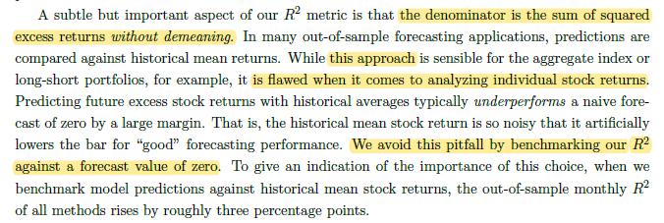
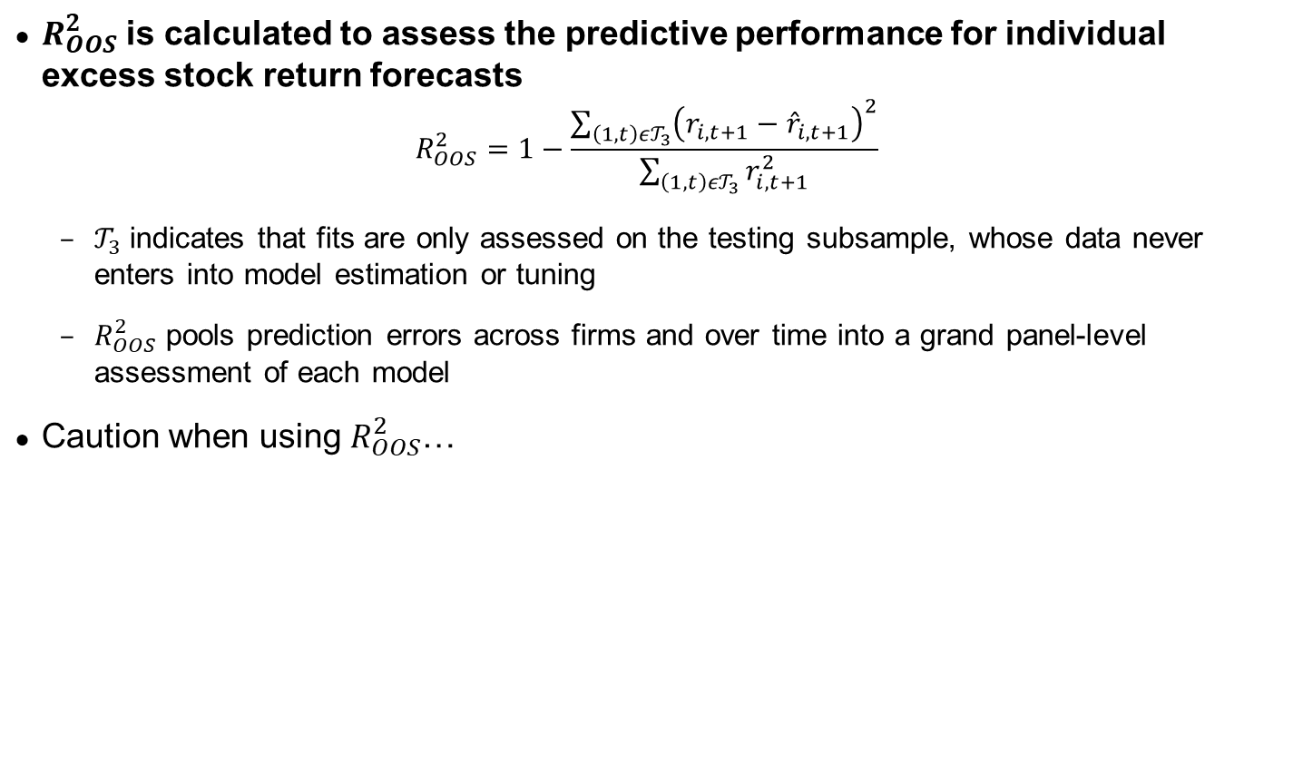
Empirical study of US equities: performance evaluation
$R_{OOS}^{2}$ is calculated to assess the predictive performance for individual excess stock return forecasts
$$R_{OOS}^{2}=1−\frac{\sum_{\left(1,t\right)ε𝒯_{3}}{{\left(r_{i,t+1}−{\hat{r}}_{i,t+1}\right)}^{2}}}{\sum_{\left(1,t\right)ε𝒯_{3}}{r_{i,t+1}^{2}}}$$
$𝒯_{3}$ indicates that fits are only assessed on the testing subsample, whose data never enters into model estimation or tuning
$R_{OOS}^{2}$ pools prediction errors across firms and over time into a grand panel-level assessment of each model
Caution when using $R_{OOS}^{2}$…
Gu, S., Kelly, B., Xiu, D. Empirical Asset Pricing via Machine Learning, The Review of Financial Studies, Volume 33, Issue 5, May 2020, Pages 2223–2273.

Slide 7
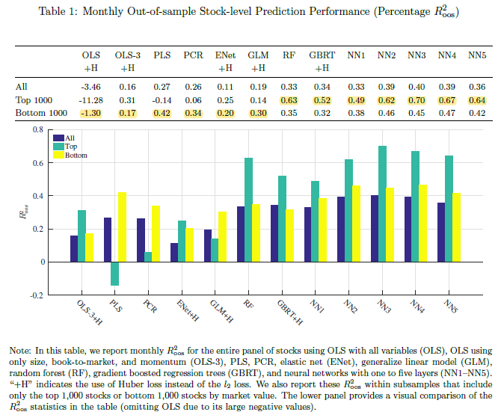


Empirical study of US equities: the cross section of individual stocks
Comparison of ML techniques in terms of their $R_{OOS}^{2}$
First row reports entire pooled sample
OLS model produces negative $R_{OOS}^{2}$
Restricting OLS to a sparse parametrization generates substantial improvements
Linear model via dimension reduction (PLS / PCR) further improves predictions and compete with boosted trees / RF
GLM with group lasso fails to improve as spline functions may not be capturing interaction among features
NNs are the best performing nonlinear method and best predictor overall as they capture complex predictor interactions, but benefits of “deep” learning may be limited to 3 layers…
2nd and 3rd rows breakout predictability for large and small stocks subsamples
General patterns carry
Tree methods and NNs are especially successful among large stocks
Gu, S., Kelly, B., Xiu, D. Empirical Asset Pricing via Machine Learning, The Review of Financial Studies, Volume 33, Issue 5, May 2020, Pages 2223–2273.

Slide 8
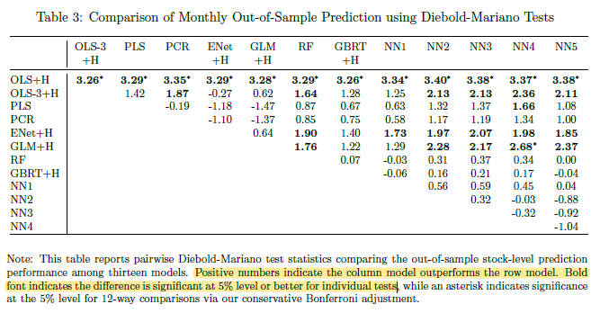
Empirical study of US equities: the cross section of individual stocks
Statistical significance of differences among models at the monthly frequency
Constrained linear models produce statistically significant improvements over the unconstrained OLS model, although there’s little difference in the performance of penalized linear methods and dimension reduction methods
Tree methods uniformly improve over linear models, but improvements are marginally significant
NNs are the only models that product large and significant statistical improvements over linear and generalized linear models
Gu, S., Kelly, B., Xiu, D. Empirical Asset Pricing via Machine Learning, The Review of Financial Studies, Volume 33, Issue 5, May 2020, Pages 2223–2273.

Slide 9
Empirical study of US equities: which covariates matter?
Models are in close agreement regarding the most influential stock-level predictors, which can be grouped into four categories:
1
2
3
4
Recent price trends
Liquidity variables
Risk measures
Valuation ratios and fundamental signals
ST reversal
Stock momentum
Momentum change
Industry momentum
Recent maximum return
LT reversal
Turnover and turnover volatility
Log market equity
Dollar volume
Amihud illiquidity
Number of zero trading days
Bid-ask spread
Total and idiosyncratic return volatility
Market beta
Beta-squared
Earnings to price
Sales to price
Asset growth
Number of earnings increases
Momentum in Hou, Xue and Zhang (2018)
Value & Investment
Gu, S., Kelly, B., Xiu, D. Empirical Asset Pricing via Machine Learning, The Review of Financial Studies, Volume 33, Issue 5, May 2020, Pages 2223–2273.

Slide 10
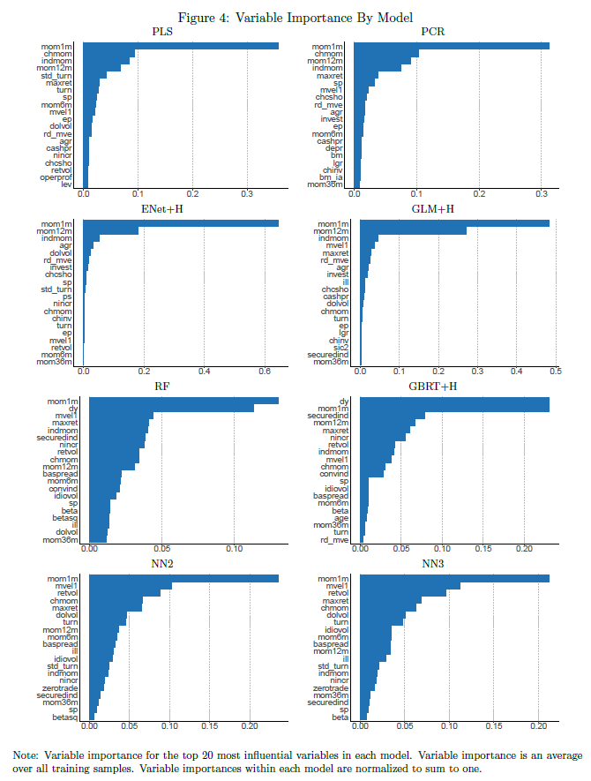
Empirical study of US equities: which covariates matter?
Reports importance of the top 20 stock-level characteristics for each method
Indicators importance magnitude for penalized linear models and dimension reduction models are highly skewed toward momentum and reversal
Trees and neural networks are more democratic, drawing predictive information from a broader set of characteristics
Gu, S., Kelly, B., Xiu, D. Empirical Asset Pricing via Machine Learning, The Review of Financial Studies, Volume 33, Issue 5, May 2020, Pages 2223–2273.

Slide 11
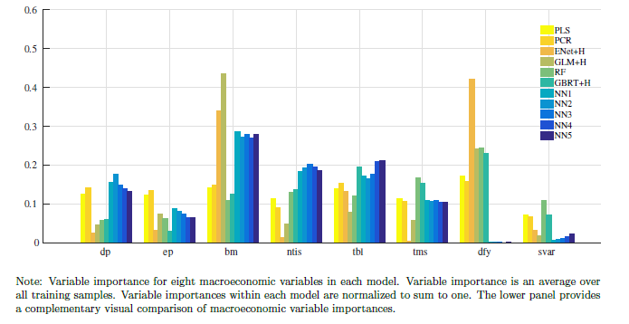
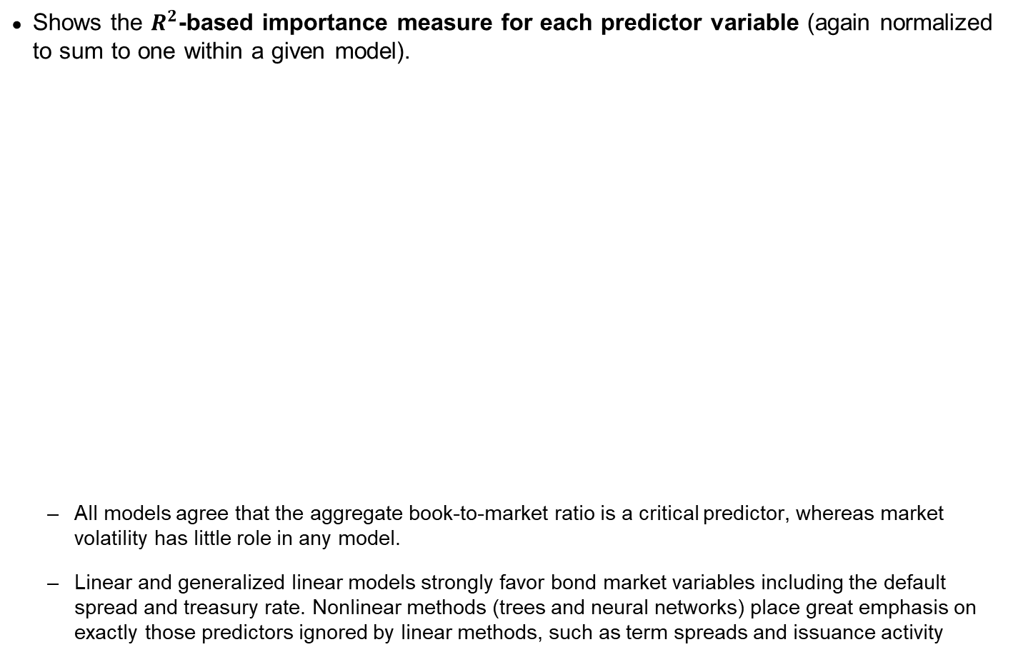
Empirical study of US equities: which covariates matter?
Shows the $R^{2}$-based importance measure for each predictor variable (again normalized to sum to one within a given model).
All models agree that the aggregate book-to-market ratio is a critical predictor, whereas market volatility has little role in any model.
Linear and generalized linear models strongly favor bond market variables including the default spread and treasury rate. Nonlinear methods (trees and neural networks) place great emphasis on exactly those predictors ignored by linear methods, such as term spreads and issuance activity
Gu, S., Kelly, B., Xiu, D. Empirical Asset Pricing via Machine Learning, The Review of Financial Studies, Volume 33, Issue 5, May 2020, Pages 2223–2273.

Slide 12
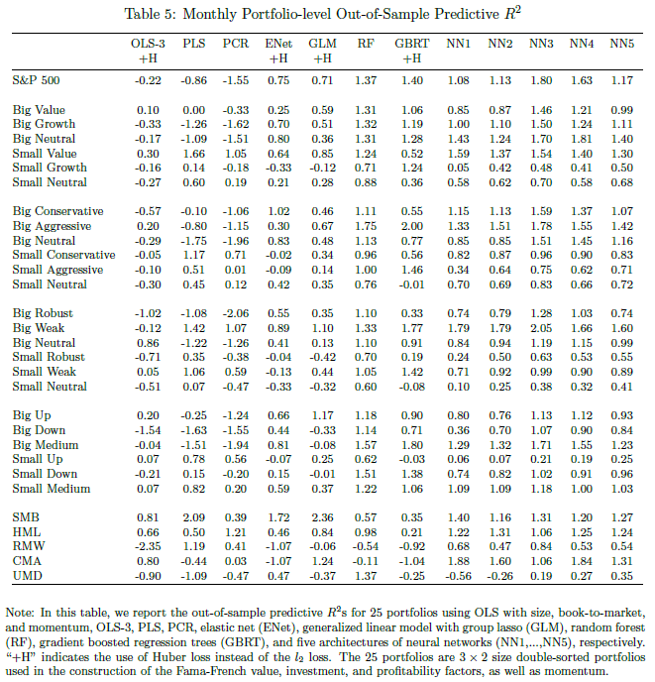
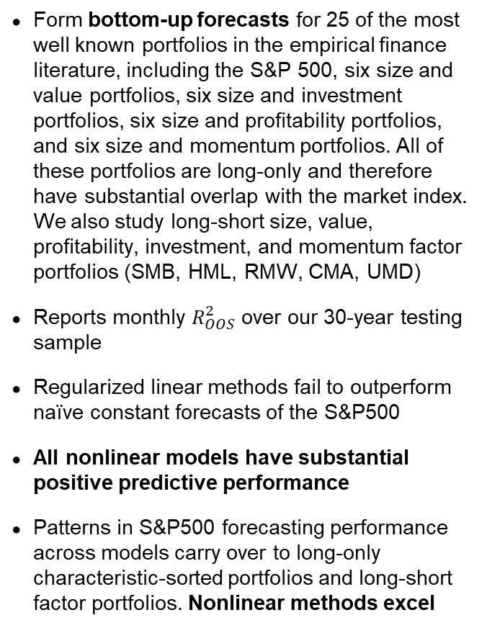
Empirical study of US equities: portfolio level performance
Form bottom-up forecasts for 25 of the most well known portfolios in the empirical finance literature, including the S&P 500, six size and value portfolios, six size and investment portfolios, six size and profitability portfolios, and six size and momentum portfolios. All of these portfolios are long-only and therefore have substantial overlap with the market index. We also study long-short size, value, profitability, investment, and momentum factor portfolios (SMB, HML, RMW, CMA, UMD)
Reports monthly $R_{OOS}^{2}$ over our 30-year testing sample
Regularized linear methods fail to outperform naïve constant forecasts of the S&P500
All nonlinear models have substantial positive predictive performance
Patterns in S&P500 forecasting performance across models carry over to long-only characteristic-sorted portfolios and long-short factor portfolios. Nonlinear methods excel
Gu, S., Kelly, B., Xiu, D. Empirical Asset Pricing via Machine Learning, The Review of Financial Studies, Volume 33, Issue 5, May 2020, Pages 2223–2273.

Slide 13
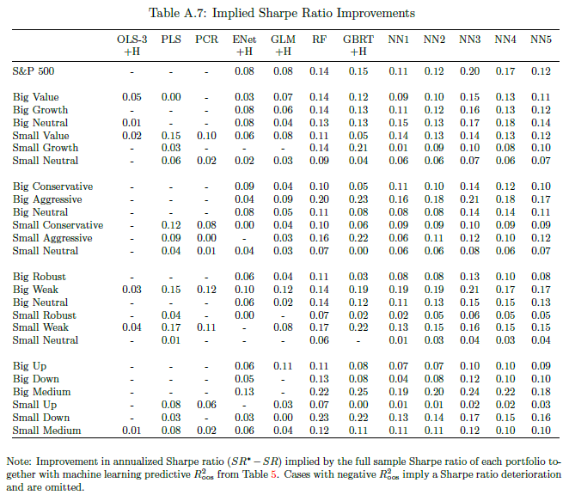
Empirical study of US equities: portfolio level performance
Form bottom-up forecasts of S&P 500, six size and value portfolios, six size and investment portfolios, six size and profitability portfolios, and six size and momentum portfolios, plus long-short SMB, HML, RMW, CMA, UMD
Reports improvement in annualized Sharpe ratio for an investor exploiting ML predictions for portfolio timing in order to assess the economic magnitudes of portfolio predictability
NN3 for example improves the buy-and-hold Sharpe ratio of the S&P500 by 0.20
For characteristic-based portfolios, nonlinear ML help improve Sharpe ratios by anywhere from few percentage points to over 24 percentage points
Gu, S., Kelly, B., Xiu, D. Empirical Asset Pricing via Machine Learning, The Review of Financial Studies, Volume 33, Issue 5, May 2020, Pages 2223–2273.

Slide 14
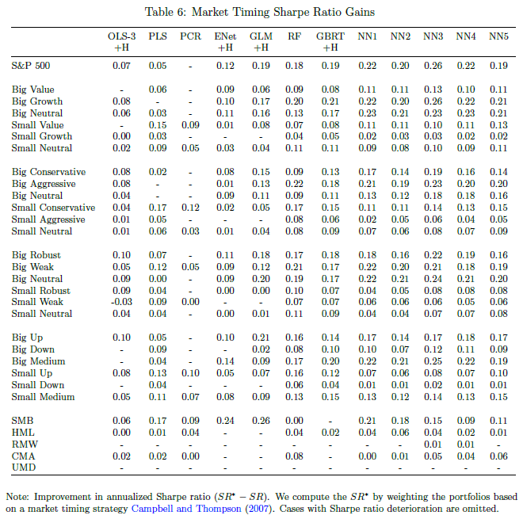
Empirical study of US equities: portfolio level performance
Form bottom-up forecasts of S&P 500, six size and value portfolios, six size and investment portfolios, six size and profitability portfolios, and six size and momentum portfolios, plus long-short SMB, HML, RMW, CMA, UMD
We can also assess the economic magnitudes of portfolio predictability with a market timing trading strategy
Table reports annualized Sharpe ratio gains (relative to a buy-and-hold strategy) for timing strategies based on ML
The strongest and most consistent trading strategies are those based on nonlinear models, with NNs the best overall
Gu, S., Kelly, B., Xiu, D. Empirical Asset Pricing via Machine Learning, The Review of Financial Studies, Volume 33, Issue 5, May 2020, Pages 2223–2273.

Slide 15
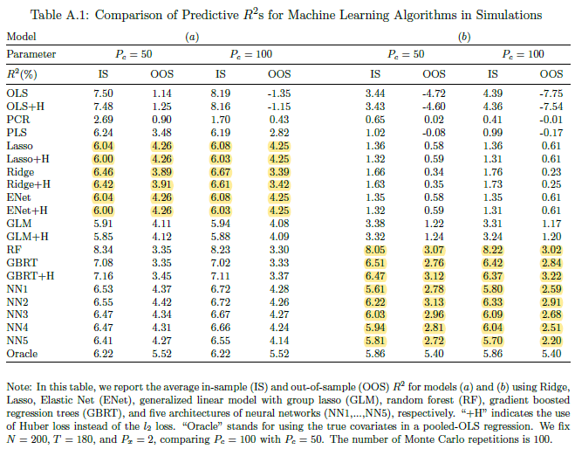
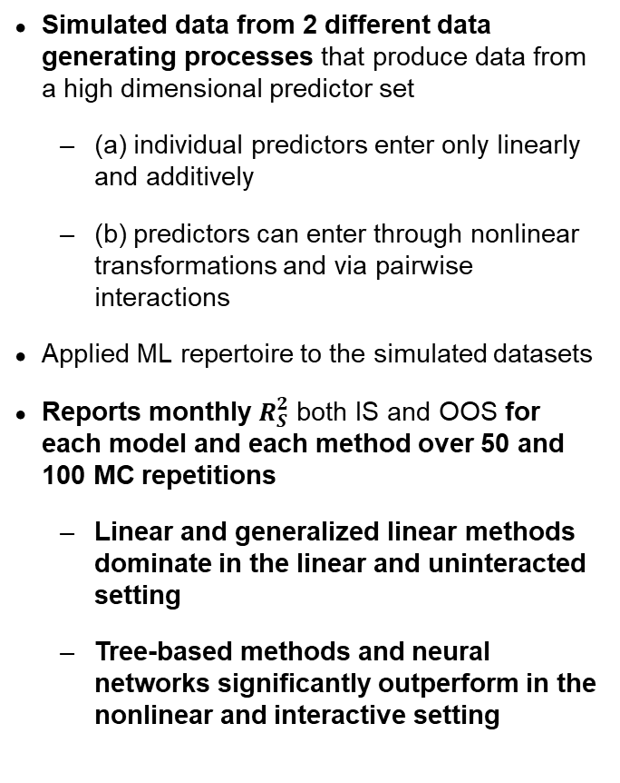
Simulation of 3 factor model
Simulated data from 2 different data generating processes that produce data from a high dimensional predictor set
(a) individual predictors enter only linearly and additively
(b) predictors can enter through nonlinear transformations and via pairwise interactions
Applied ML repertoire to the simulated datasets
Reports monthly $R_{S}^{2}$ both IS and OOS for each model and each method over 50 and 100 MC repetitions
Linear and generalized linear methods dominate in the linear and uninteracted setting
Tree-based methods and neural networks significantly outperform in the nonlinear and interactive setting
Gu, S., Kelly, B., Xiu, D. Empirical Asset Pricing via Machine Learning, The Review of Financial Studies, Volume 33, Issue 5, May 2020, Pages 2223–2273.

Slide 16
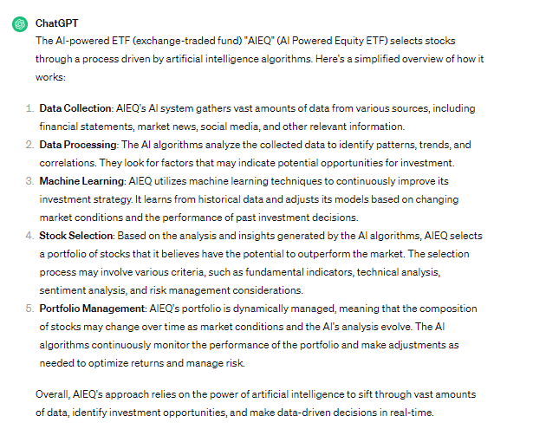
Finally, an AI-powered ETF
AIEQ ETF, powered by IBM Watson
How EquBot is beating the market with AIEQ, the AI-powered ETF
https://www.ibm.com/blog/equbot-aieq-ai-powered-etf/

Slide 17
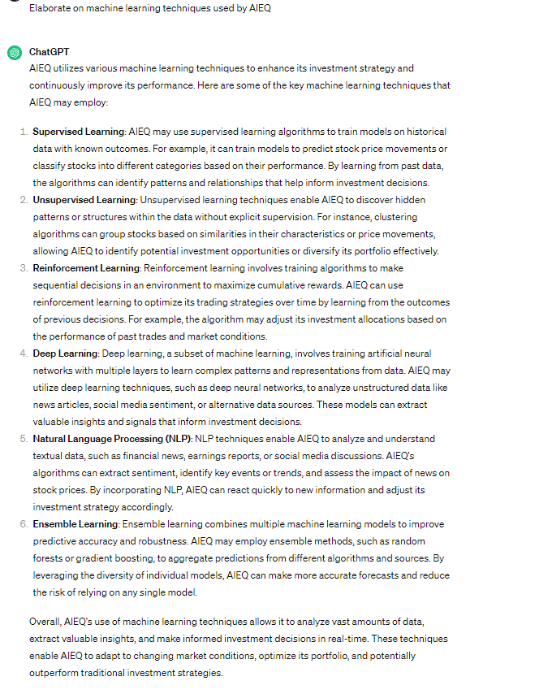

Slide 18
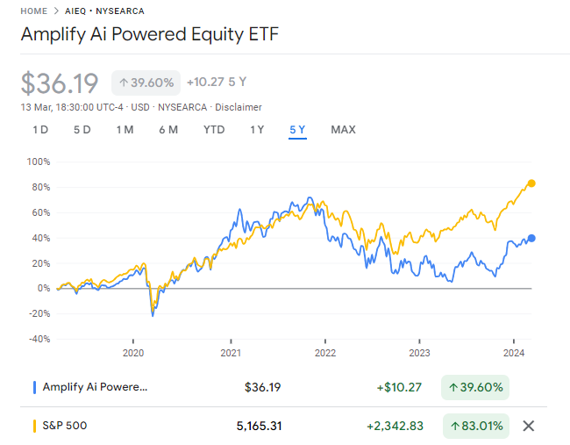
Performance vs S&P 500

Slide 19
Lecture 5 Exercise
Compare different neural network methods vs. linear regression and select based on OOS R2 performance and portfolio performance.

